Slide 1

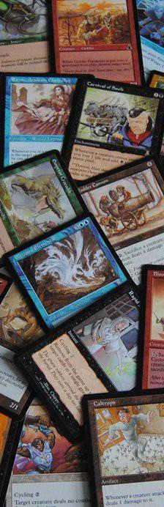
HOBBY STORE ONLINE PLATFORM
For The Sword & Board

Slide 2
TEAM MEMBERS
Nolan Honey Lead /Back-End
Harry Archer UI / Back-End
Saif Mustaf UI / Back-End
Jan Farun Database / Back-End
Nikolas Andrew Di Domenico UI / Back-End

Slide 3
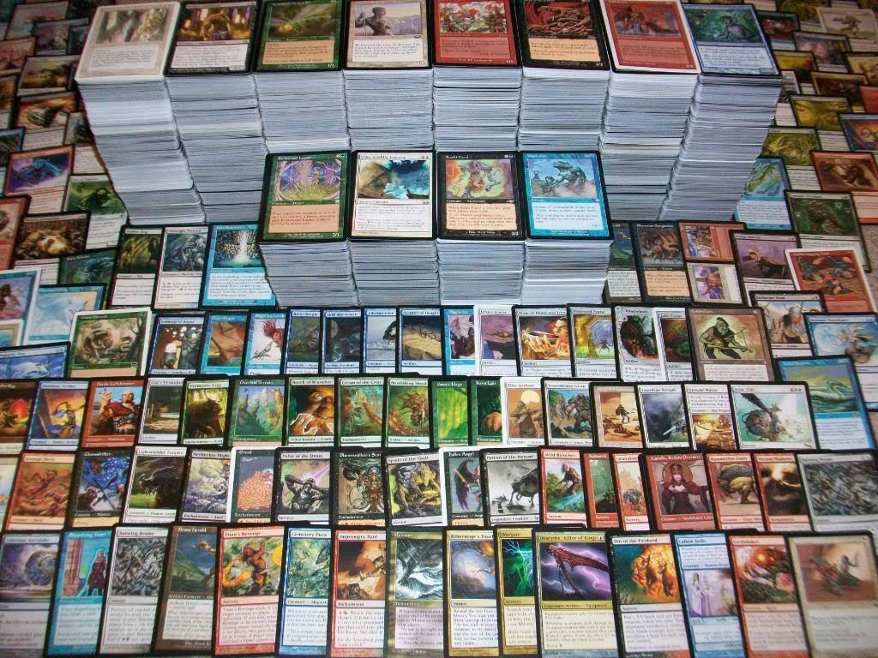
AGENDA FOR OUR PRESENTATION…
Project description by Harry Archer
In-Scope by Nolan Honey
Out-of-Scope by Saif Mustaf
Detailed Demo of Mock up/Prototype by Nikolas Andrew Di Domenico
Technology Requirements by Jan Farun
Conclusion by Saif Mustaf
Q & A

Slide 4
PROJECT DESCRIPTION
Our project is based around the Magic: The Gathering (MTG) card game. We have teamed up with The Sword & Board Toronto, a local hobby shop to create an Online Marketing Platform (OMP) to boost their online presence. Our Project will:
Allow employees to manage card inventory
Allow customers to search card database for prices
Allow Customers to purchase Cards online
Allow Employees to manage customers with Efficiency

Slide 5
In-Scope: For the Store
Store Credit webform for employees to fill out
Store Credit database to maintain customer store credit balances
Online portal for customers to view their store credit pages
Card database which will mirror the official database
Card prices, which will be scraped from competitors using;
a web crawler
A system to allow managers to manage which parts of the application are available, as well as making employee accounts and overseeing account activity

Slide 6
In-Scope: For the Project
Everything that was in-scope for the Store, plus:
A stores stock of cards
shopping cart functionality, expandable to other products
Please note that these are all in scope. We intend for the software to be modular, allowing stores to only enable the parts they want.

Slide 7

Out-of-Scope
Analytic tools to allow store employee’s to analyze sales statistics, popular hours, where traffic comes from, etc.
Full website deployment package. This would include all basic functions that you would need to run a small hobby store business.
Provide Advertisement space for future possibilities of selling that space to market other gaming platforms, products, tournaments etc.

Slide 8
Detailed Demo
of Mock up/Prototype

Slide 9

Technology Requirements
Our team needs great technologies for our web application to come true.

Slide 10

Stack

Slide 11



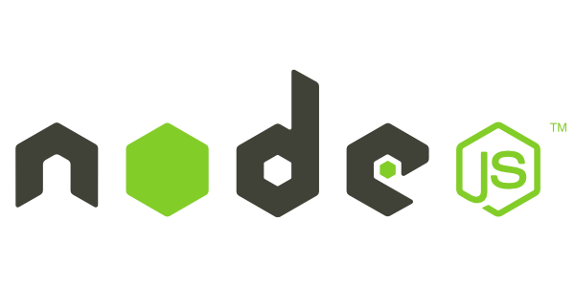
MongoDB is the leading NoSQL database, empowering businesses to be more agile and scalable.
Express is a minimal and flexible node.js web application framework, providing a robust set of features for building single and multi-page, and hybrid web applications.
AngularJS lets you extend HTML vocabulary for your application. The resulting environment is extraordinarily expressive, readable, and quick to develop.
Node.js is a platform built on Chrome’s JavaScript runtime for easily building fast, scalable network applications.

Slide 12
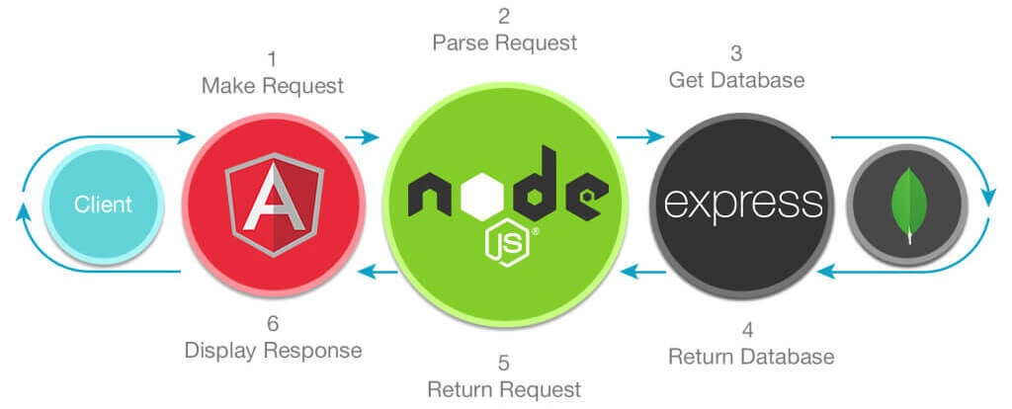

Slide 13
CONCLUSION

Slide 14
THANK YOU
FIRST UP CONSULTANTS

Slide 15
Q & A
FIRST UP CONSULTANTS

